Slide 1
Radicalisation and social media
The Get SMART team
Venue:
Date:

Slide 2
What is radicalisation?
Nicky Reilly
He was from Plymouth
He was 22 years old
He had autism and learning difficulties
He was radicalised online
He attempted to bomb an Exeter restaurant
He was jailed for at least 18 years
He died in prison in 2016

Slide 3
Damon Smith
He was 20 years old
He has autism
He is from Newton Abbot
He planted a home-made bomb on the underground
He used an online magazine to make bomb
He was sent to prison for 15 years

Slide 4
Lloyd Gunton
17-years-old
Has autism
Read things about terrorism online
Said he was going become a terrorist
In prison for at least 11 years

Slide 5
The Get SMART team
Was funded by Google and ISD (Institute for Strategic Dialogue)
A peer education project for young people with learning disabilities
They talked about their life online
They talked about extremism, radicalisation and terrorism
They heard from experts
This is what they learned!

Slide 6
Group
Respect and help each other
Say if you are finding it difficult
Be calm and patient
Keep things confidential
Be honest
If you have a question please put your hand up

Slide 7
Today we will talk
about...
Social media: what is good and bad about it
Radicalisation
How to stay safe online
What to do if you are worried

Slide 8
What is social media?
Phone, tablet, computer
Things like Facebook, Twitter, Instagram, Snapchat
On-line gaming
Dating sites
A way of keeping in touch, finding out what is happening, making friends

Slide 9
In small groups…
Group A: What is good about social media?
Group B: What is bad about social media?

Slide 10
We said…
Everybody has got it, you want it
It’s fun
It’s sociable
You can keep in touch with people
It helps you be creative
It helps me get better at things
People try to make you feel angry

Slide 11
Social media
Is life online better than real life?

Slide 12
Is life online better?
“You can do things online you can't do in real life.”
“You can be someone different.”
“You can have whatever you want.”
“A gaming group can become like your family.”
“Life online is better, but you still have to learn how to deal with real life.”

Slide 13
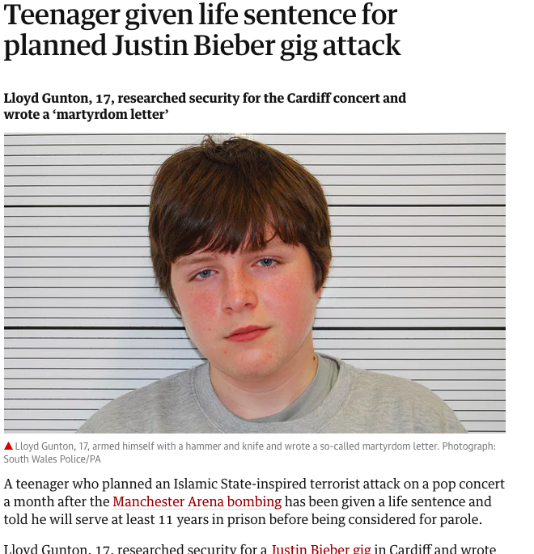
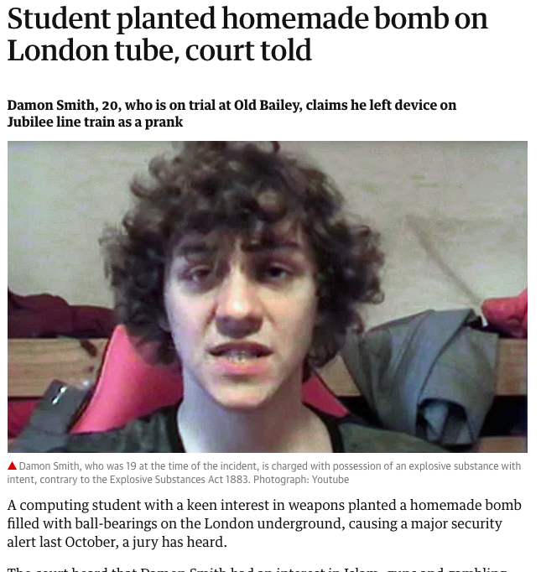
What is ‘radicalisation’?
Talk about it at your tables
Write down what you think on the paper
You have 5 minutes

Slide 14
What we said about radicalisation
“People feel bad about themselves and take it out on other people.”
“People think it's cool.”
“People are curious.”
“They are looking for people who understand them.”
“It is like being reborn.”
“It gives people a place in the world.”

Slide 15
Are you ready to play...

Slide 16
Before we start...
If someone thinks you are being radicalised they can tell a special Police team, called Prevent.
This is known as being referred to the Prevent team.
You will need to remember this!

Slide 17
Question 1

Slide 18
Compared with the rest of England…
A Nobody in Devon is being radicalised.
B Fewer people are radicalised.
C It’s about the same as the rest of England.
D More people are radicalised in Devon.

Slide 19
Question 1
A
B
C
D Devon is a high referral area for Prevent.

Slide 20
1,000

Slide 21
Question 2

Slide 22
In Devon most extremism is…
A religious
B left wing
C right wing
D supporting Plymouth Argyle

Slide 23
Question 2
A
B
C 80% of referrals to Prevent are for right-wing extremism
D

Slide 24
10,000

Slide 25
Question 3

Slide 26
In Devon how many referrals are about people with learning disabilities or autism?
A 10%
B 25%
C 50%
D 75%

Slide 27
Question 3
A
B
C
D Three in four of all people referred to Prevent have a learning disability/autism.

Slide 28
Why is this?
Any thoughts?
The Get SMART team said:
“We find it harder to make friends.”
“We can find a community online.”
“People with autism like following rules.”
“We don’t see why people would lie to us.”

Slide 29
100,000

Slide 30
Question 4

Slide 31
When people are being radicalised, this mostly happens…
A On the street
B At political meetings
C Online
D At the church or mosque

Slide 32
Question 4
A
B
C More than half of grooming for radicalisation is taking place online.
D

Slide 33
250,000

Slide 34
Question 5

Slide 35
In Devon most referrals to Prevent are for . . .
A girls and women
B boys and men
C it’s about the same
D we don’t know, no records are kept

Slide 36
Question 5
A
B Nearly all (95%) are boys/men.
C
D

Slide 37
Why is this?
Any thoughts?
The Get SMART team said:
Boys can be less grown up!
Boys are more likely to game online.
Boys are often more violent.
Boys are less likely to share their problems.

Slide 38
500,000

Slide 39
Question 6

Slide 40
Question 6 What might tell you someone is being radicalised . . .
A secretive internet use
B sudden interest in religion or politics
C people losing touch with family and friends
D sharing an interest in violent images

Slide 41
All of them! Any of these might tell you someone is being radicalised . . .
A secretive internet use
B sudden interest in religion or politics
C people losing touch with family and friends
D sharing an interest in violent images

Slide 42
1,000,000

Slide 43
Congratulations! You are a winner!

Slide 44
Grooming: how it happens
Identify a vulnerable person.
Befriend and support them.
Isolate them from their friends and family.
Change what they believe.
Recruit them.

Slide 45
Grooming
The Get SMART team watched a video about a man called Adam Deen.
He was groomed and joined a terrorist group.
When the team talked about him they said…

Slide 46
Grooming
“He was looking for people to understand him.”
“He was taken in by powerful images.”
“He was interested in the ideas, and that was exploited.”
“The group filled a hole for him. It must have been like being reborn.”
“It was a gradual process.”
“He felt obliged, like it was his duty.”
“It gave him a sense of belonging, like he had a place in the world.”
“The group leader became his father figure.”

Slide 47
How can we all stay safer online?
Do you really know who you are talking to?
Don’t share too much about yourself.
Look at your privacy settings.
Don’t friend anyone you don’t really know.
Don’t believe everything people online tell you.
If something scares or upsets you, tell someone!
Who would you tell if you thought someone was being radicalised?

Slide 48
Finally…
Does anyone have any questions?
Please fill in your quiz.

Slide 49
Thanks for joining in! - The Get SMART team

